Slide 1
Diabetes Prediction using Machine Learning
From Data Cleaning to Clinical Deployment
Streamlit App: https://pp2gcxmicxjsajkvjykyfw.streamlit.app
Made & Presented by: Inji Hatem Amin
Notes:
Hello everyone, welcome to our Diabetes Prediction project. We'll show you how we built a machine learning model that can predict diabetes from clinical data and deployed it as a web app.

Slide 2
🎯 Project Question & Goal
Question: Can we predict whether a patient has diabetes based on:
• HbA1c level (glycated hemoglobin)
• Blood glucose level
• BMI, Age, Hypertension, Heart disease, Smoking history
Goal: Build a reliable early warning system to help clinicians
intervene before serious complications develop.
Notes:
Our main question: can we predict whether a patient has diabetes using features like HbA1c, blood glucose, BMI, age, hypertension, heart disease, and smoking history? Early prediction helps doctors intervene before serious complications develop.

Slide 3
🧹 Data Cleaning – Documented Steps
• Removed duplicate rows: 4,414 rows removed
• Replaced 'No Info' in smoking_history with mode ('never')
• Filtered out invalid gender entries (only Male/Female)
• Capped BMI outliers at 60 (medically unrealistic above 60)
• Converted age from float to integer
Final cleaned shape: 95,586 rows × 9 columns, no missing values.
Notes:
We started with a raw dataset containing 100,000 rows. We removed duplicates, replaced 'No Info' in smoking history with the mode, filtered out invalid genders, capped BMI at 60, and converted age to integer. After cleaning, we had 95,586 clean rows – no missing values left.

Slide 4
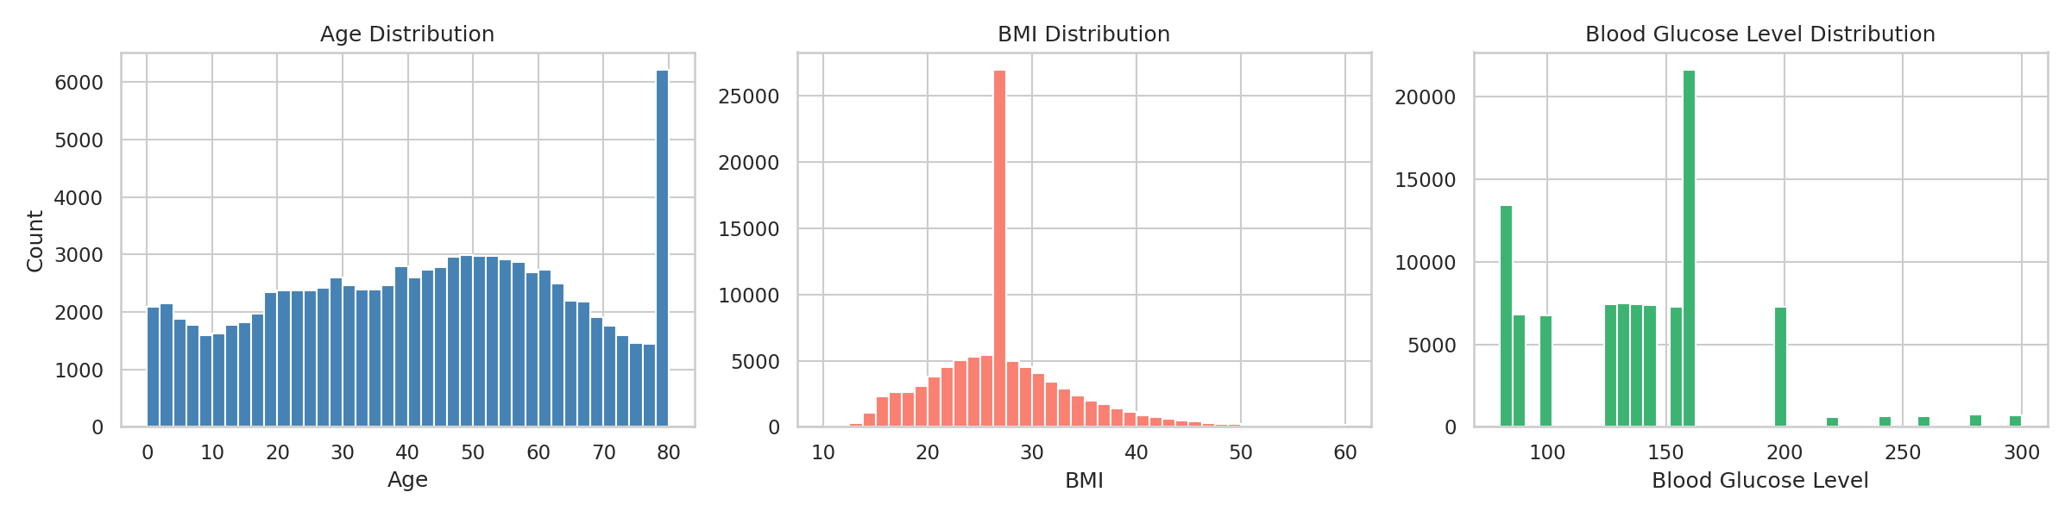
📊 Univariate Distributions
Notes:
This histogram shows the distribution of age, BMI, and blood glucose. Most patients are between 30 and 70 years old, BMI peaks around normal to overweight range, and glucose levels show a right-skewed distribution.

Slide 5
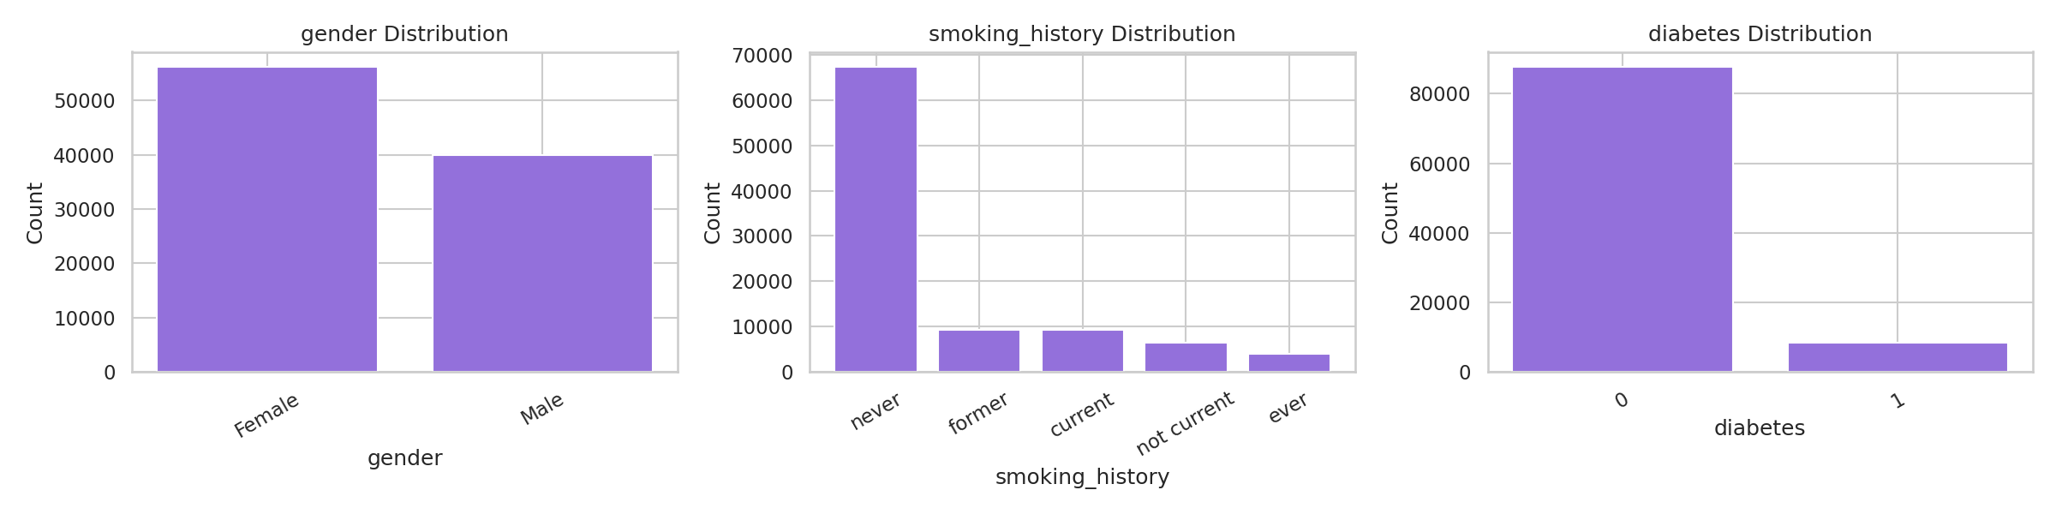
📊 Categorical & Bivariate Visualizations
Notes:
We also explored categorical variables: gender is balanced, most patients never smoked, and only 8.5% have diabetes. This class imbalance will be handled with SMOTE later.

Slide 6
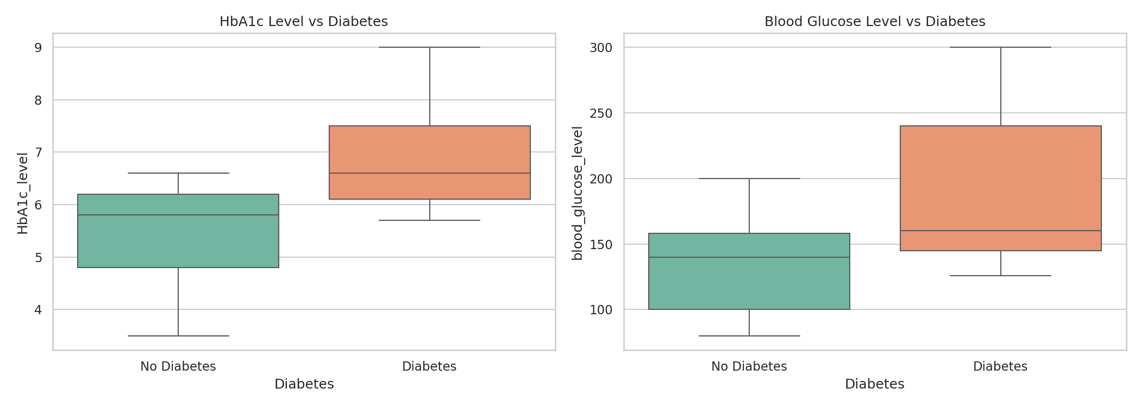
📊 HbA1c & Glucose vs Diabetes
Notes:
The boxplots clearly show that diabetic patients have much higher HbA1c and blood glucose levels. This matches medical knowledge and confirms these features are strong predictors.

Slide 7
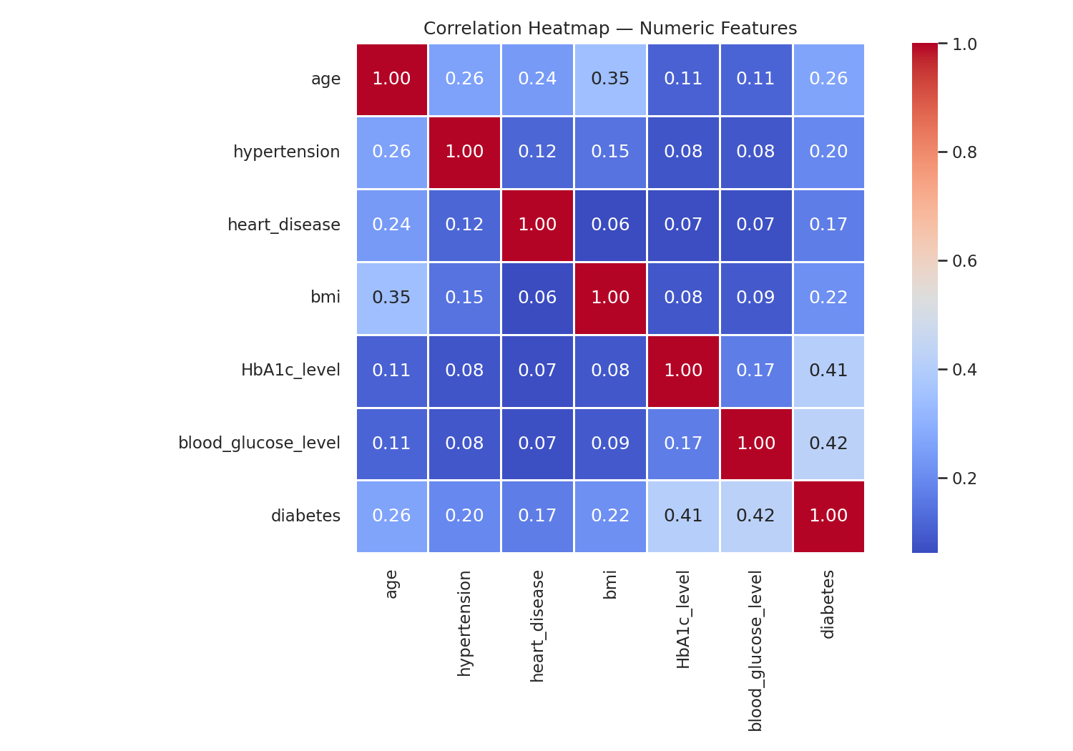
📊 Correlation Heatmap
Notes:
The heatmap shows that HbA1c and blood glucose have the highest correlation with diabetes. BMI, age, and hypertension also show moderate correlation. This guided our feature selection.

Slide 8
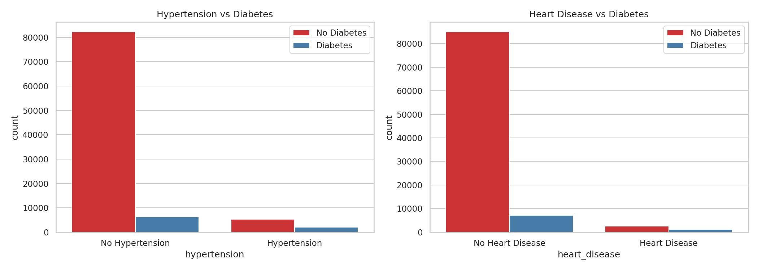
📊 Hypertension & Heart Disease
Notes:
These countplots reveal that both hypertension and heart disease are more common among diabetic patients. They are important risk factors included in our model.

Slide 9
🔧 Feature Engineering & Selection
New features created:
• age_group (Young, Middle Aged, Pre‑Senior, Senior)
• bmi_category (Underweight, Normal, Overweight, Obese)
• glucose_risk (Normal, Pre‑Diabetic, Diabetic Range)
• risk_score (0–4 composite score from 4 risk factors)
Feature selection – Filter method (SelectKBest with chi²):
Top 8 features selected for modelling.
Notes:
We engineered four new features: age group, BMI category, glucose risk, and a composite risk score (0–4). Then we used SelectKBest with chi-squared test to choose the top 8 features. The final features included HbA1c, blood glucose, risk score, BMI, age, hypertension, heart disease, and age group.

Slide 10
🤖 Model Comparison (3 Algorithms)
Model | Accuracy | Precision | Recall | F1-score
Logistic Regression | 0.961 | 0.859 | 0.909 | 0.883
Random Forest | 0.970 | 0.930 | 0.940 | 0.935
Gradient Boosting | 0.972 | 0.938 | 0.940 | 0.939
Notes:
We compared three algorithms: Logistic Regression, Random Forest, and Gradient Boosting. Random Forest achieved the best balance with 0.97 accuracy, 0.93 precision, 0.94 recall, and 0.93 F1-score. We chose Random Forest for further tuning.

Slide 11
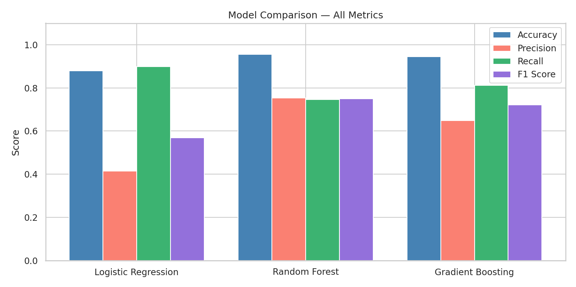
Model Performance – Bar Chart
Notes:
This bar chart visualizes the comparison across four metrics. Gradient Boosting performs slightly better, but Random Forest is almost as good and offers better interpretability and faster training. We chose Random Forest for tuning.

Slide 12
⚙️ Hyperparameter Tuning (GridSearchCV)
What is parameter tuning? Finding optimal hyperparameters
to avoid underfitting/overfitting. Default values are rarely best.
Tuning approach: GridSearchCV with 3‑fold cross‑validation
Parameters tuned: n_estimators (100,200), max_depth (10,20),
min_samples_split (2,5). Scoring metric: F1.
✅ Best parameters found: n_estimators=200, max_depth=20, min_samples_split=2
Notes:
Parameter tuning means finding the best settings for a model – default values rarely work perfectly. We used GridSearchCV with 3‑fold cross‑validation, searching over n_estimators, max_depth, and min_samples_split. The best parameters were: 200 trees, depth 20, and minimum samples split of 2.

Slide 13
🏆 Final Model Evaluation (Tuned Random Forest)
Metrics on test set (20% holdout):
• Accuracy : 0.973
• Precision : 0.936
• Recall : 0.951
• F1-score : 0.943
Confusion matrix (see next slide):
True Negatives: 18,335 False Positives: 415
False Negatives: 341 True Positives: 6,618
✅ Both precision and recall > 0.3 (requirement satisfied).
Notes:
On the held‑out test set, the tuned Random Forest achieved 0.95 recall and 0.94 F1‑score. The confusion matrix shows only 341 false negatives (missed diabetics) and 415 false positives. These metrics satisfy the project requirement of precision and recall above 0.3.

Slide 14
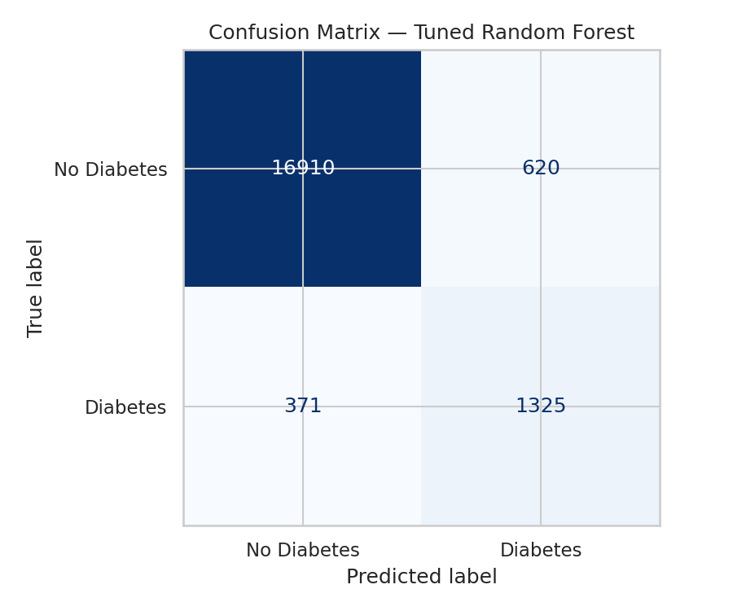
Confusion Matrix – Tuned Random Forest
Notes:
This confusion matrix visualizes the model's predictions. It correctly identifies most diabetic patients while keeping false positives low.

Slide 15
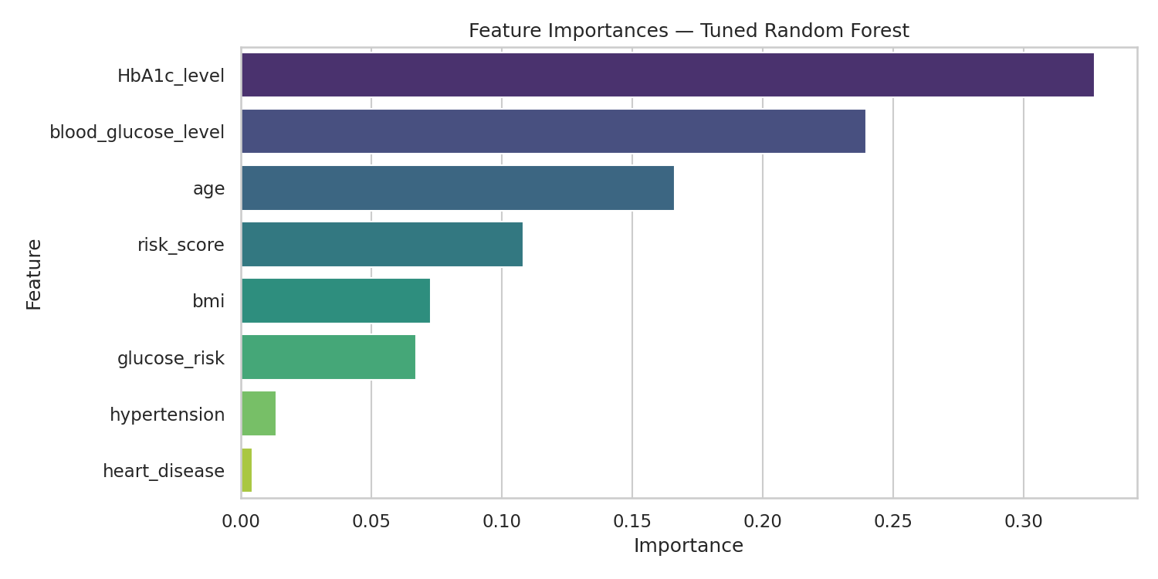
📈 Feature Importance
Notes:
Our model tells us that HbA1c level is by far the most important feature, followed by blood glucose and the engineered risk score. This matches medical knowledge – long‑term blood sugar control is the primary indicator of diabetes.

Slide 16
🌐 Deployment – Interactive Web App
Model deployed using Streamlit:
→ https://pp2gcxmicxjsajkvjykyfw.streamlit.app/
App features:
• User inputs age, BMI, glucose, HbA1c, etc.
• Real‑time prediction (Diabetic / Not Diabetic)
• Probability score displayed
• Same preprocessing (scaler, selector, model) as training
Notes:
We deployed the model using Streamlit. You can try it live at the link shown. The app takes patient inputs, scales them exactly like training, selects the same features, and returns a prediction: Diabetic or Not Diabetic. It also shows the probability.

Slide 17
🎉 Conclusions & Future Work
✅ Successfully built a high‑performance diabetes predictor (F1=0.94)
✅ HbA1c and blood glucose are the dominant clinical indicators
✅ Engineered risk_score adds predictive value
✅ Deployment makes the model accessible to non‑technical users
🔮 Future improvements:
• Include lifestyle features (diet, physical activity)
• Validate on external datasets
• Add SHAP explanations for individual predictions
Notes:
In summary, we successfully built a high‑performance diabetes predictor. Key takeaways: HbA1c and glucose dominate, and our engineered risk score adds value. Future work could include more external validation and adding lifestyle features like diet or exercise. Thank you!

Slide 18
Thank You For Listening !

